Slide 1


Indian Institute of Information Technology Bhagalpur
Project Title:
Artificial Intelligence Powered Tool to Track and Optimize Student Activity Online
Members Name: Roll No. Branch:
Rounak Sinha (2101086CS) CSE
Aman Kumar Singh (2101140CS) CSE
Sagar Vishwakarma (2101160CS) CSE
Utkarsh Kumar (2001015) CSE
Under Guidance of
Dr. Ujjwal Biswas
Notes:
2

Slide 2
Presentation Outline
Introduction: Context, challenges, and the proposed AI-driven system.
Problem Statement: Exploring the complexities of efficient time management in the digital age.
Methodology: A holistic approach combining training, software, and organizational policies.
Results Analysis: Analyzing the performance of the system and its impact on user productivity.
Conclusion: Comprehensive approach to enhancing productivity through AI.
References: Key references and additional resources.
Notes:
2

Slide 3
Introduction
Context
Challenge
Solution
Significance
Digital tools and remote work have transformed the way we work, requiring new approaches to productivity monitoring.
Traditional methods like manual tracking and self-reporting often fall short in capturing real-time insights.
An AI-driven system integrating process tracking and facial recognition technology.
Provides real-time insights into user engagement, potentially revolutionizing productivity assessment.
Notes:
2

Slide 4

Problem Statement
Modern Dilemma
Key Issues
Inefficient time management is a pervasive challenge for individuals and organizations.
Lack of prioritization, procrastination, and constant digital distractions hinder focus.
Consequences
Need for Solutions
Poor time management impacts productivity, well-being, and overall quality of life.
Effective tools are needed to monitor and enhance productivity in the digital age.
Notes:
4

Slide 5

Objectives & Motivation
Empower Individuals
Integration of Technology
Develop training programs to enhance time management skills, focusing on prioritization, scheduling, and distraction management.
Implement advanced time tracking and management software with real-time tracking and reporting features.
Policy Development
Create workplace policies that support efficient time management, promoting flexible work hours and reducing unnecessary meetings.
Notes:
5

Slide 6
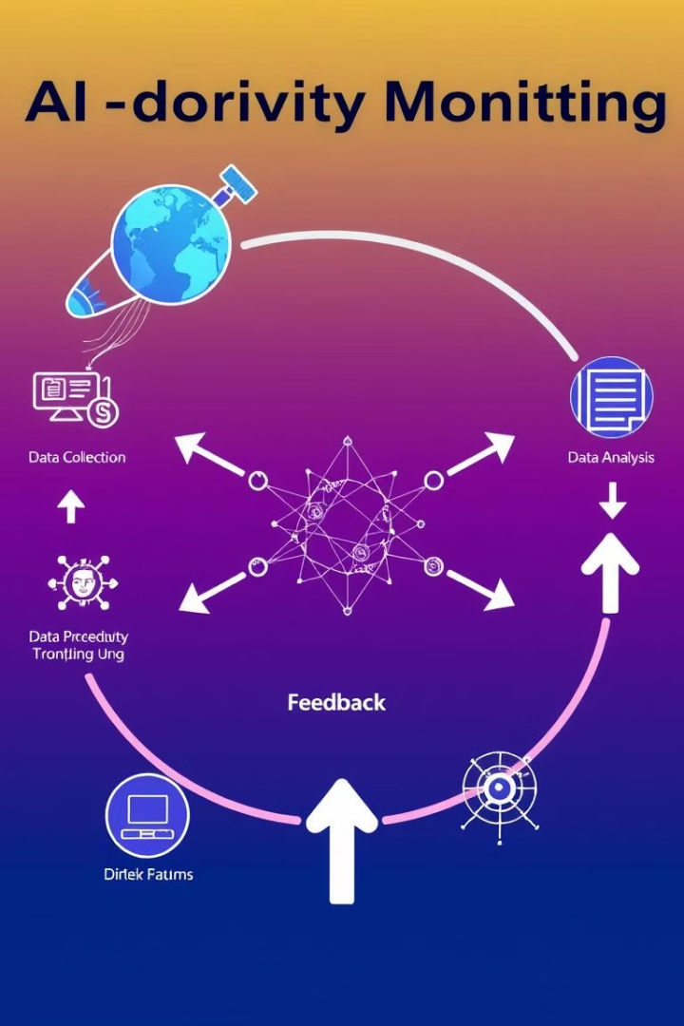
Methodology Overview
A holistic approach combining training, software tools, and organizational policies for maximum impact.
1
Leveraging advanced technologies like process tracking and facial recognition to provide real-time insights.
2
Continuous monitoring of user activity to provide actionable feedback, empowering users to optimize their workflow.
3
Notes:
6

Slide 7
Detailed Methodology
Data Collection
Model Selection
Synchronized data from process tracking and AFK detection modules, including active window titles, user attentiveness status, and eye aspect ratio (EAR).
Supervised learning approach to achieve accurate predictions, testing algorithms like Decision Trees, SVMs, Neural Networks, RNNs, and LSTMs.
Notes:
7

Slide 8
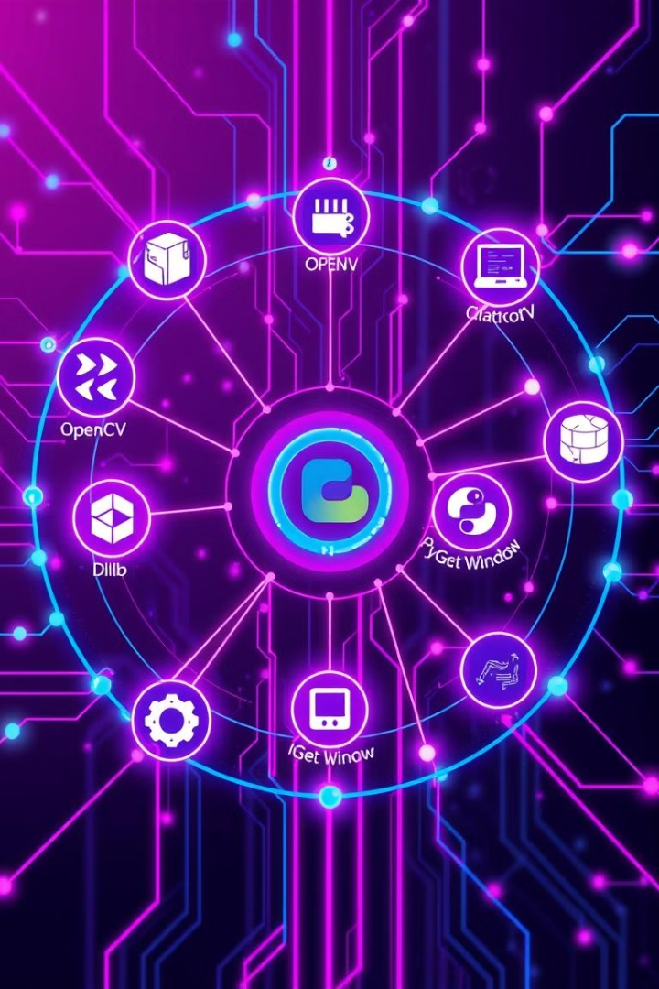


Implementation Details
Software & Tools
OpenCV and Dlib for facial recognition and tracking, PyGetWindow for monitoring active applications, Python for model development and integration.
Training Procedures
Data preparation involves cleaning, normalization, and feature engineering, followed by model training with hyperparameter tuning and validation.
Notes:
8

Slide 9
Here add screenshot
Notes:
10

Slide 10
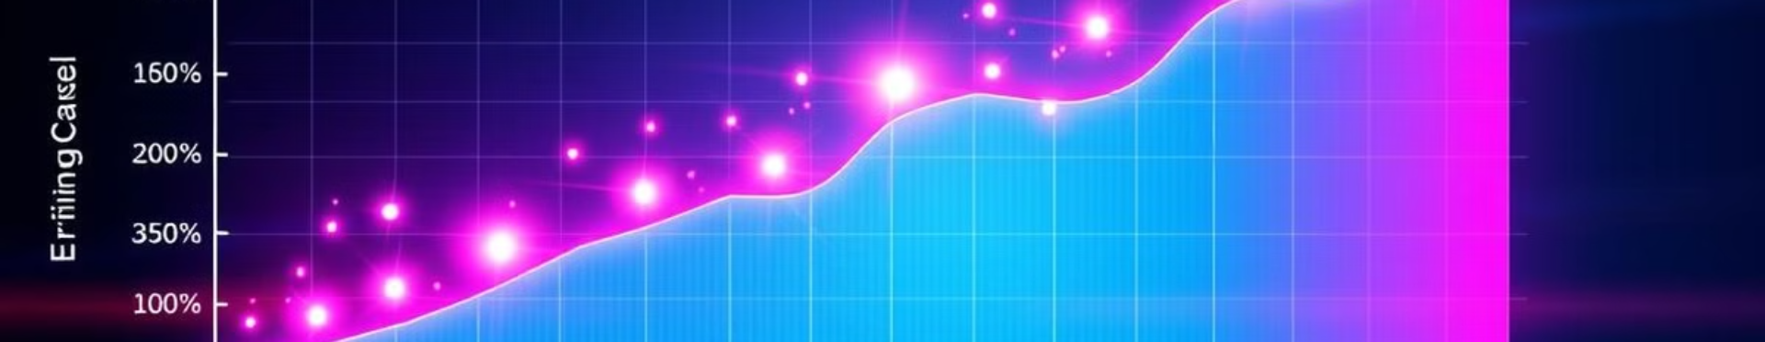
Results Analysis
90%
85%
88%
Accuracy
Precision
Recall
The AI model achieved a high accuracy rate of 90%, demonstrating its ability to accurately predict user productivity states.
A precision score of 85% indicates that the model effectively identifies true positive cases, minimizing false positives.
A recall rate of 88% indicates that the model accurately identifies most true positive cases, minimizing false negatives.
Notes:
9

Slide 11



Conclusions & Next Steps
Improved Productivity
1
The AI-driven system demonstrated significant improvements in user engagement and productivity metrics post-implementation.
Real-time Insights
2
The system provides valuable real-time insights, allowing users to understand their peak productivity hours and common distractions.
Future Directions
3
Explore integration with other productivity tools, continuous improvement of the AI model with more diverse datasets, and addressing privacy concerns.
Notes:
10

Slide 12
Thank You
Notes:
10

